Slide 1
AI-Powered Smart OCR Scanner and Translation Deployed on Edge Devices

Slide 2
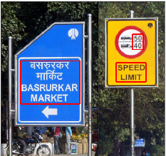
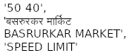
OCR & Language Translation
Fast text detection, recognition, translation on mobile devices and embedded AI platforms
Detect
&
Recognize
(EasyOCR)
Translate
(MarianMT)
'50 40',
'BASRURKAR MARKET
BASRURKAR MARKET',
'SPEED LIMIT'
Img1&2 src: EasyOCR - https://github.com/JaidedAI/EasyOCR

Slide 3
Importance
Could be paired with automated environment scanners (or guide dogs) and text-to-voice readers to help blind people traverse cities
Language-naïve foreigners
Traversing cities
Teachers reading student handwriting
Scanning receipts
Shopping on online sites or street markets where copy-paste or translation isn't provided by default
Reading PDFs or old manuscripts written in foreign (but not rare) languages

Slide 4
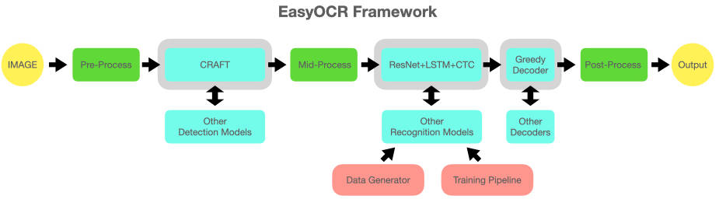
EasyOCR Model Structure
|--------Recognition--------|
Detection
CNN+RNN+Loss
Text From Image
Input
Possible replacements
CRAFT => DETR
CRAFT evaluates scene to identify bounding boxes containing text
Greedy Decoder (fast) => Beam Search (highest prob) or MBR (human-accurate)
Recognition:
Resnet => Extract Img Features
LSTM => Predict Text Features Token By Token
CTC => Form Ordered Sequences From Characters
Decoder => Pick Best Predicted Sequence
Img src: EasyOCR - https://github.com/JaidedAI/EasyOCR
Notes:
EasyOCR requires that you provide it a set of languages that the image’s text will be written in. It does NOT translate between languages, it simply reads text off of images.
CRAFT’s authors do not provide libraries for training (private Intellectual Property).
CRAFT is designed for scene-text detection and isn’t a burdeningly-large-storage-size transformer like DETR.
EasyOCR does not use attention (nor self-attention), where each token is aware of the importance of each other token in the sequence (sentence).
EasyOCR uses feature extraction via convolution (CNN/ResNet) combined with a sequence-based predictor (RNN) and a sequence-based loss function (CTC).
Greedy Decoder: Always chooses the most probable next token when creating text from the image.
CTC = Connectionist Temporal Classification. Predicts alignment of output text, deleting empty spaces and extra/repeated characters predicted by LSTM. Temporal because columns of the singular line of text are considered 1D rather than a 2D spatial context.
MBR = Minimum Bayes Risk Decoding (minimizes loss value via picking highest similarity in top predictions, regardless of model probabilities)

Slide 5
Overall Process
EasyOCR
CRAFT (Text Detection)
ResNet, Bidirectional LSTM, CTC (Text Recognition)
MarianMT (Lang2Lang Translation)

Slide 6
Papers
Notes:
Due to the popularity of Resnet and LSTM, I will focus on CRAFT.
Due to time constraints, I did not write thorough explanations of CTC nor Greedy Decoders.

Slide 7
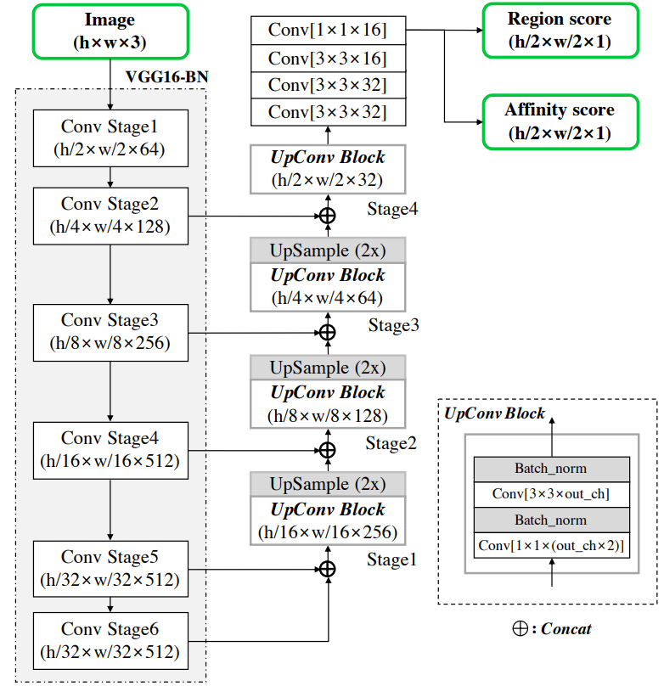
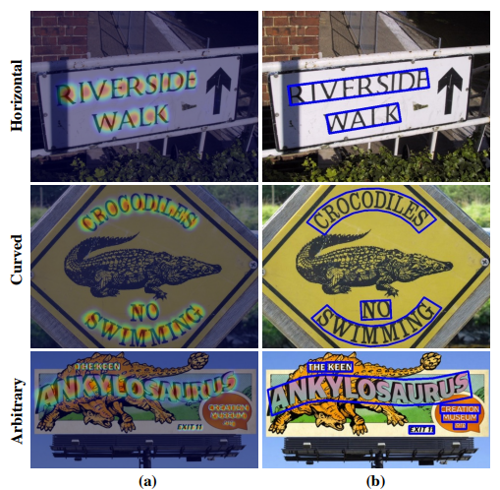
CRAFT Character-Region Awareness For Text Detection
Img src: CRAFT paper - https://arxiv.org/pdf/1904.01941
Notes:
If you read literature and see the phrase “Curved text”, the middle row’s picture is what it means.
“Curved text” doesn’t mean Italics or Cursive, it means text that is not aligned to a single axis but rather along a curve that can be described by a function, such as sine or a parabola or a more complicated function. Paper alludes to polygons being used though.
Character spacing can be arbitrary, especially with misaligned fonts that attempt to be monospace (each character tries to take up equal space).
The backbone is the outdated VGG-16.
The (hxwx3) means that you can submit an arbitrarily-sized image.
Like a transformer-based recognizer such as TrOCR, the image will get resized in CRAFT.
In TrOCR, the image gets resized to where each dimension is a multiple of the image patch size.
In CRAFT, the image gets resized (preserving aspect ratio), usually to a smaller size, then the detected characters get resized (also preserving aspect ratio).

Slide 8
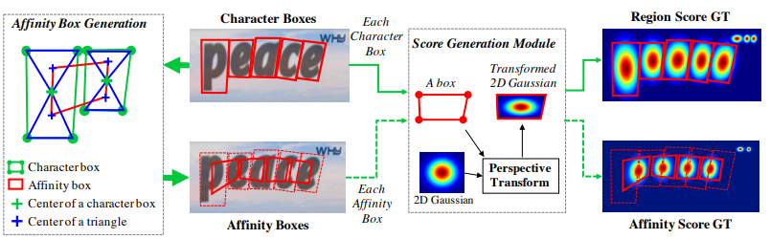
CRAFT
Region score – location of each char’s center. Affinity score – chains/strings.
Heatmap, not binary segmentation – multiple correct positions
Img src: CRAFT paper - https://arxiv.org/pdf/1904.01941
Notes:
CRAFT is tolerant to character-scale variance (lrg vs small characters (different aspect ratios) in same word are still accurately detected)
GT = Ground Truth
Gaussian Heatmaps are more flexible than binary/discrete segmentation, perfect for multiple “correct” detections existing.
Gaussian Heatmaps are not directly computed on the characters, as it would be extremely computationally expensive. There is a single pre-computed heatmap that is then stretched to fill the affinity and character boxes.
Character “region score” determines locations of individual characters – heatmap represents probability of pixel being char’s center pixel.
Character “affinity score” determines chains/groups.
Affinity boxes are not rectangular.
Two triangles are generated by drawing diagonal lines to connect opposite corners of the box, with the triangles sharing the point of focus of the character.
Then, two centroids (centers of mass) are generated per character, one per triangle.
Then, the two centroids of one character are connected to the two centroids of a nearby character or two.

Slide 9
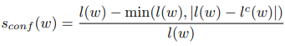
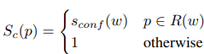
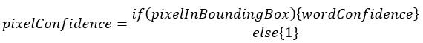
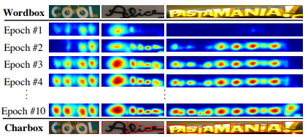
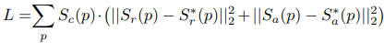
CRAFT – Training
Img src: CRAFT paper - https://arxiv.org/pdf/1904.01941
Notes:
Weakly-supervised training.
Top Formula: E.g., produces values between 0/7 (i.e., 0, or 0%) and 7/7 (i.e., 1, or 100%).
If more characters are grouped together and treated as one character (e.g., “tic” instead of “t””i””c”, the probability (confidence) drops.
Middle Formula: Pixel-wise probability map for an image. Bounding “Box” can be for char region or affinity.
Explains how the heatmaps for the Training-Epochs image was created.
I wonder if “1 otherwise” was a typo and supposed to be “0 otherwise”. It’s probably designed for the 3rd (bottom) formula such that it maximizes the total image loss when a pixel is outside the bounding box (for some reason).
Bottom Formula: The Loss function to determine how much to affect training gradients considers both the region (character location) and affinity (character chaining) scores.
The 2 pairs of vertical bars (pipes) means to get the Magnitude.
The subscript 2 combined with the 2 pairs of vertical bars means L2-Norm, which is Euclidean Distance, which is A^2+B^2=C^2 that gets turned into sqrt(A^2+B^2)=C.
The superscript 2 means “squared”, which serves to cancel out the square root from Euclidean Distance, likely to save computational power.

Slide 10
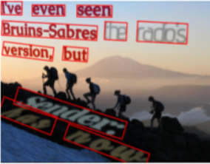
Datasets CRAFT Authors Used
SynthText (2016) - dataset of fever dreams
.8M pre-generated scenes, but can add more of your own
Used to train network base
Training 50k iters: ADAM optim + crop/rotate/color augments
Word Length confidence validates accuracy of generated pseudo-GTs
ICDAR (2013,2015,2017)
~8k training imgs total, ~10k testing imgs total
Provide quadrilaterals (for cropping annotations) & transcriptions (for calculating word length) => Used for fine-tuning training
Single-scale resolution, but scale differs among datasets.
CRAFT runs at 8.6 FPS on ICDAR-2013
ICDAR-2017 has 9 languages & most of the samples
Honorable Mentions
MSRA-TD500, TotalText (in ICDAR2017), CTW-1500
Notes:
SynthText: https://github.com/ankush-me/SynthText

Slide 11
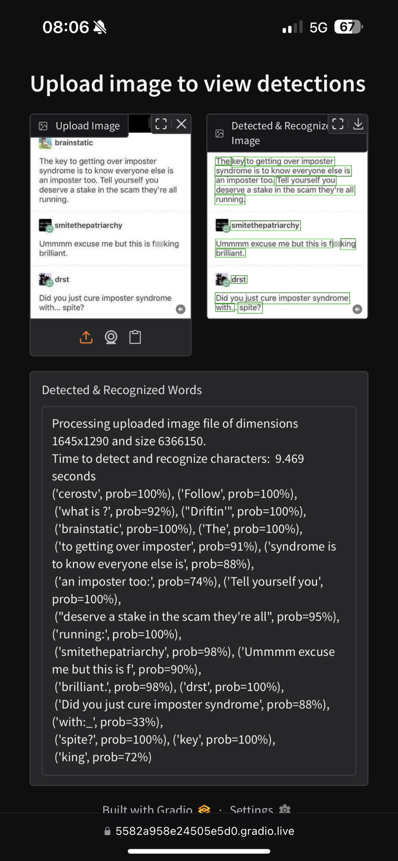
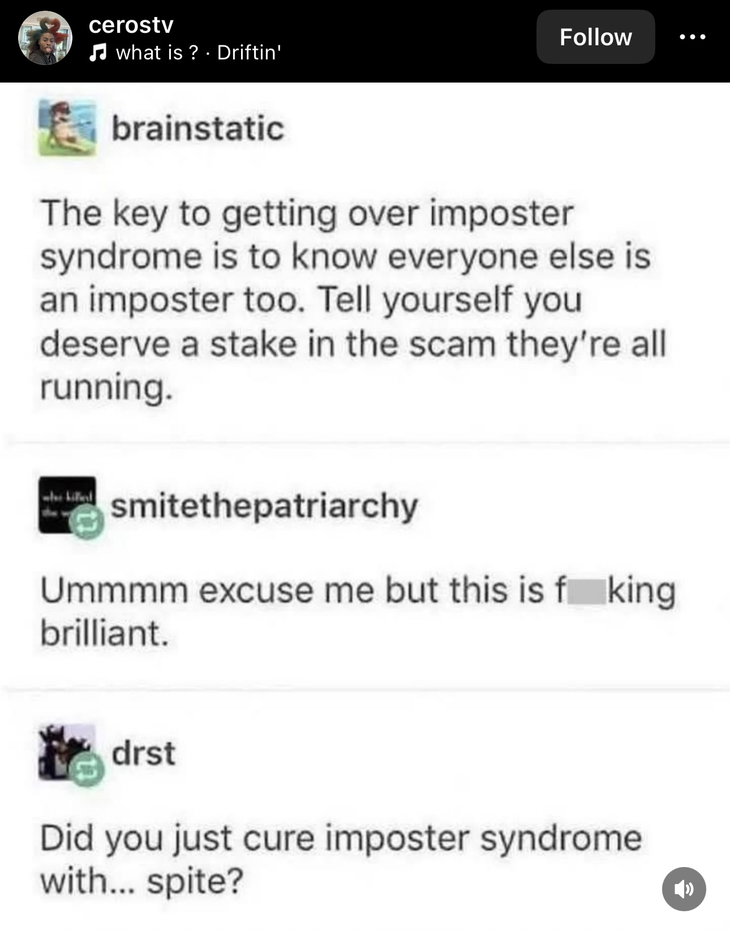
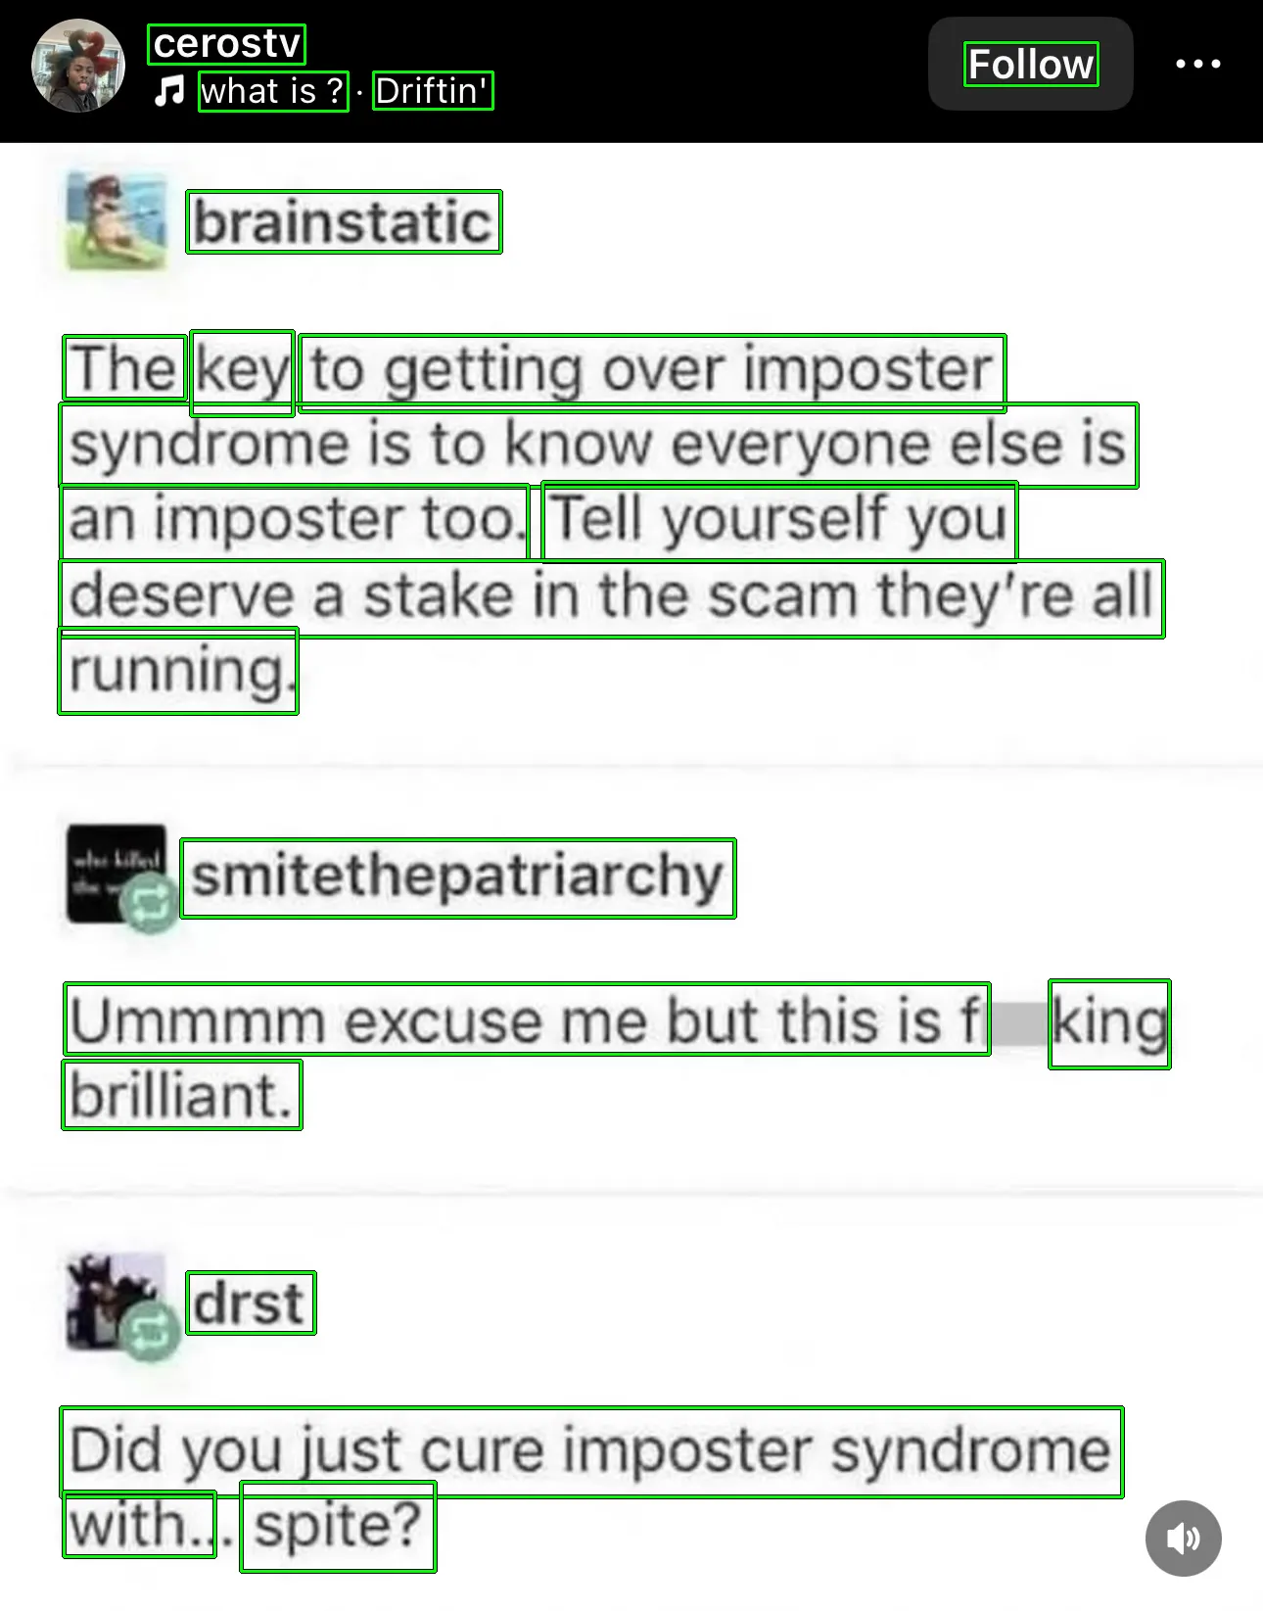
EasyOCR Results (per token)
Notes:
The text is out of order, and probabilities are mixed with tokens, making it very difficult to read. I didn’t implement a filter for xy position based ordering.

Slide 12
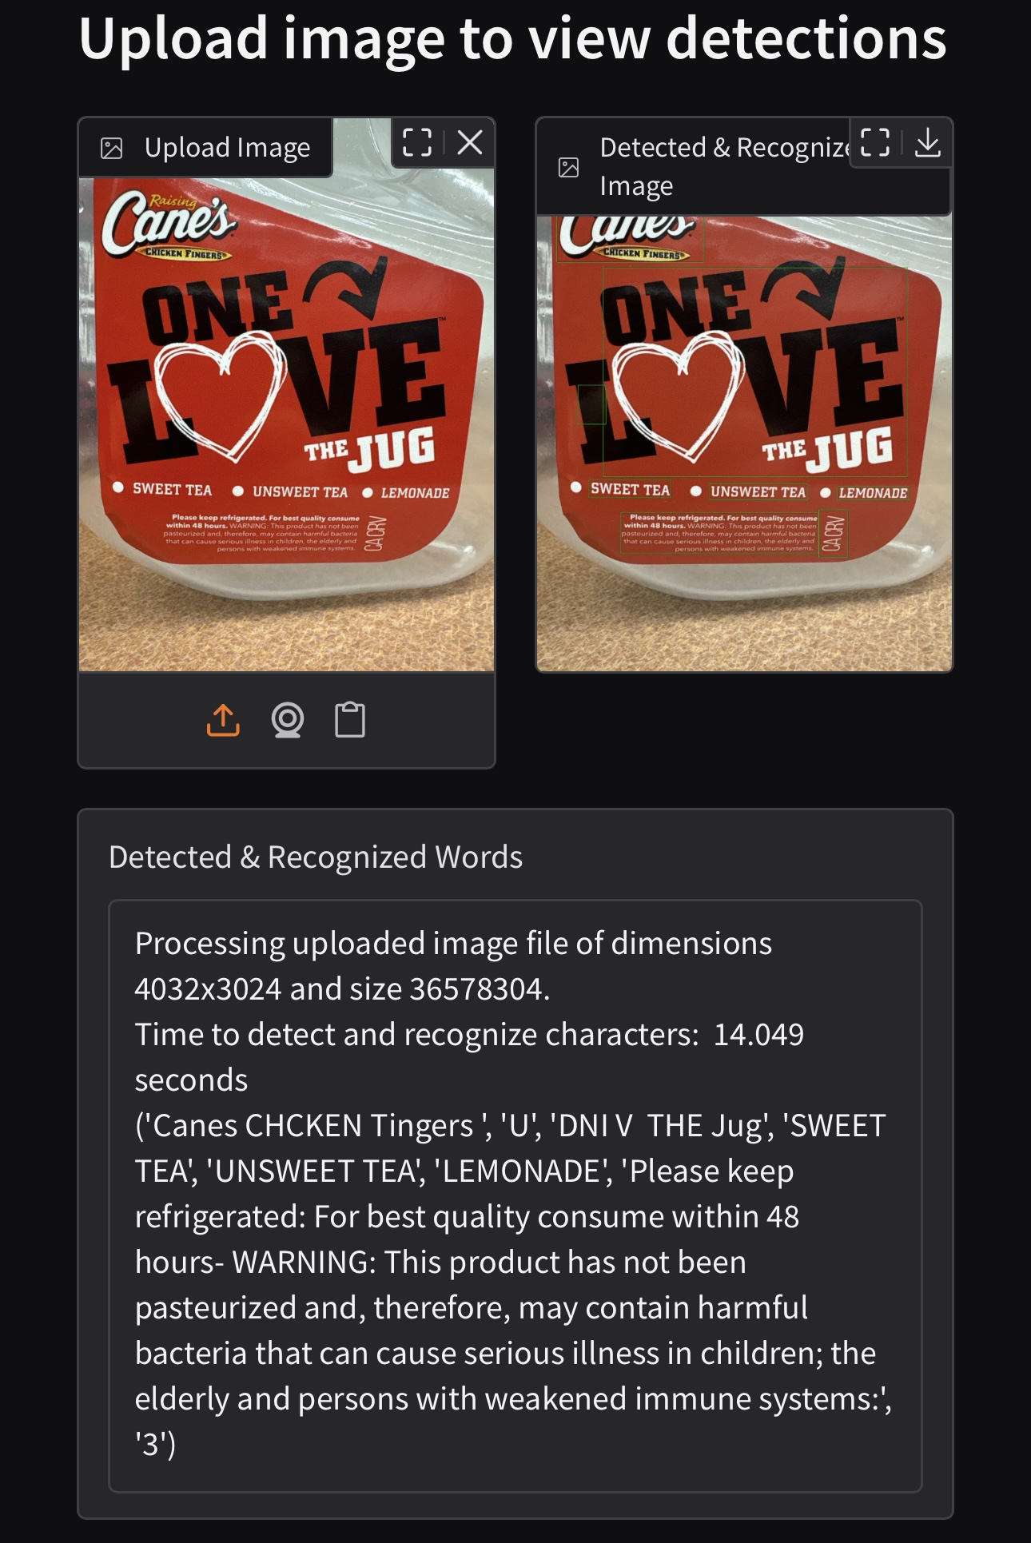
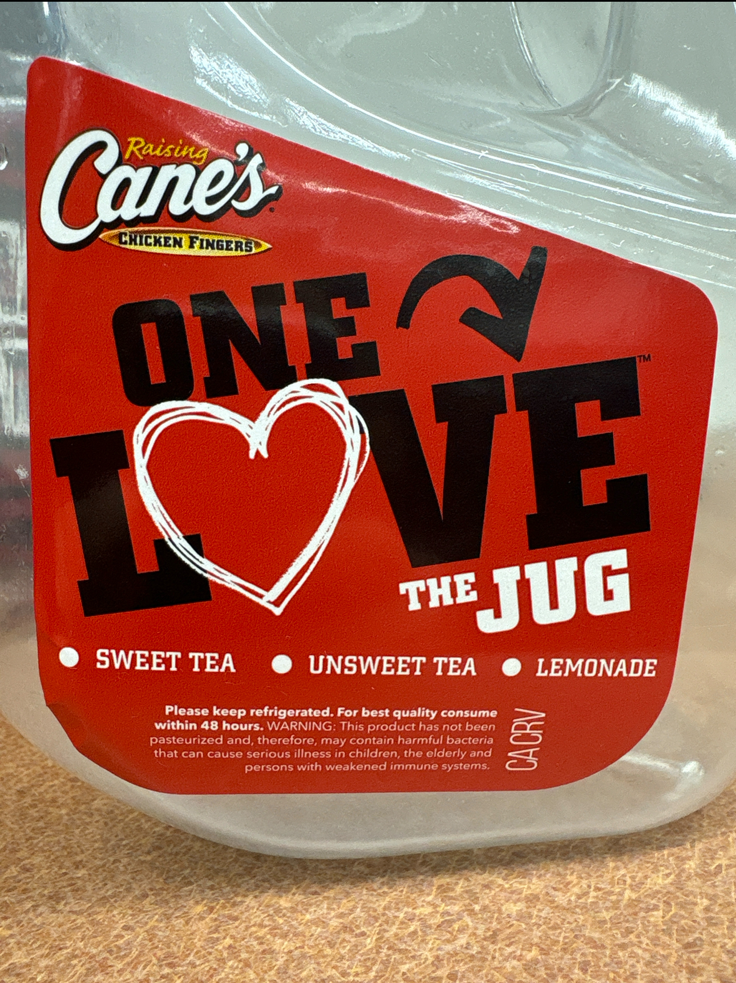
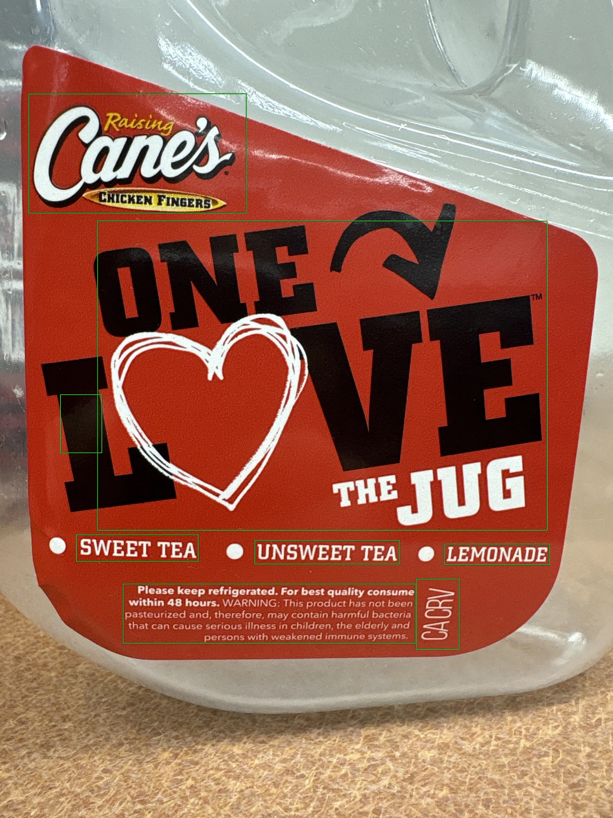
EasyOCR Results (paragraph)
Notes:
This was a high resolution image (4k by 3k), hence why the bounding boxes, which have a fixed border width of 4 pixels, appear so thin and nearly invisible.
It’s very hard to see in the image unless you zoom in a ton, but there is a strangely-shaped glare patch on the large “L” letter, which EasyOCR interprets as a separate letter.

Slide 13
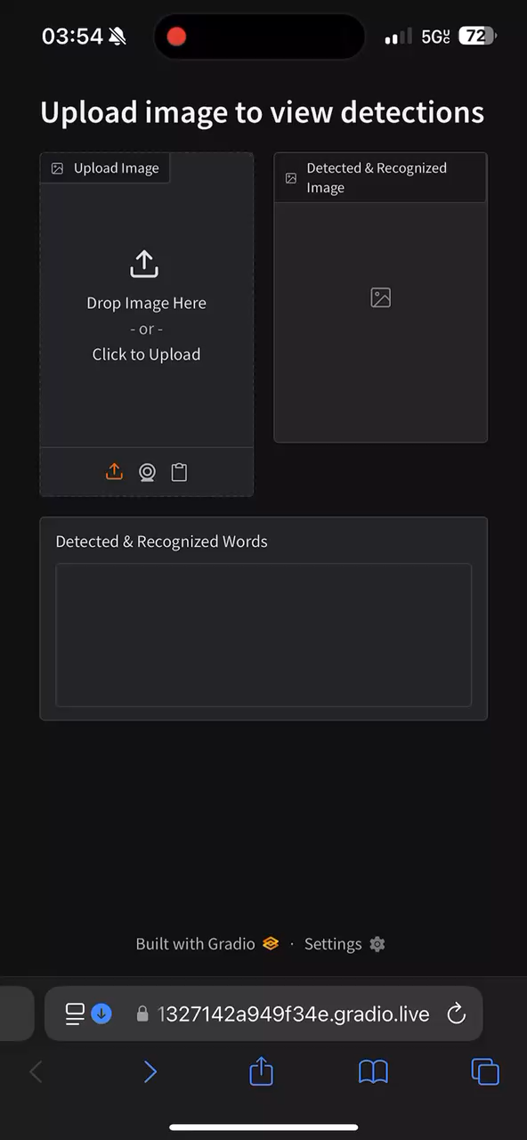
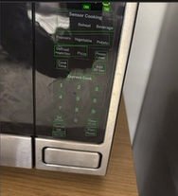
EasyOCR Demo
Result
Notes:
Note that the server is running on my computer and not my phone, but my phone took a picture and uploaded a picture to the website/server, where the picture was then processed. Lower-resolution images will be processed faster, so a downsampling option could possibly be implemented in the future for impatient users.

Slide 14
MarianMT
Pre-trained Student-Distilled/Pruned Transformer
Each lang pair usually <50MB, but drops 3-5 BLEU % points compared to full-size model
CTranslate2 – Can 8-bit quantize the model & provide faster inference
Specialized for lang translation, unlike most other translation-able models such as Google’s T5-Small
I do not yet have this implemented
Notes:
BLEU = BiLingual Evaluation Understudy

Slide 15

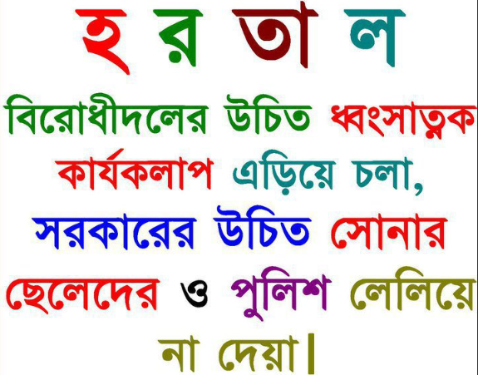
Issues
1.92 GB of libraries just for Img2Txt, not including full Python exe
{Torch, Torchvision} is 1.12 GB of that 1.92 GB.
Potential Fixes:
Dynamic Quantization: slow & less accurate, but lowers RAM & storage reqs
Quantization-Aware Training not really an option due to CRAFT
CRAFT doesn’t detect individual Arabic, Bangla characters well due to cursive connectedness
Img Srcs:
https://www.vecteezy.com/vector-art/10509793-assalamualaikum-in-beautiful-arabic-calligraphy-text-translate-peace-be-upon-you
http://hd-picture24.blogspot.ae/2012/09/excellent-bangla-text-image.html
Notes:
Dynamic Quantization:
Slows inference due to extra computations needed to pack data together
Reduces storage (due to pre-quantizing the weights, but sadly not the activations). Decreases the RAM required

Slide 16
Future Work
Implement Language Translation to at least one more language
Memory Profiling to determine RAM usage
Implement Evaluation metrics
Learn Swift and Objective-C, then upload code to Apple device

